Slide 1
EE-2003 Computer Organization & Assembly Language
INSTRUCTOR
Engr. Aashir Mahboob
Lecturer, Department of Computer Science
FAST NUCES (Karachi)
aashir.mahboob@nu.edu.pk

Slide 2
CH# 05 PROCEDURES
OUTLINE
•Stack Operations
•Defining and Using Procedures

Slide 3
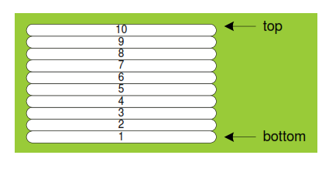
Imagine a stack of plates . . .
plates are only added to the top
plates are only removed from the top
LIFO structure

Slide 4
STACK OPERATIONS
•A stack data structure follows the same principle as a stack of plates:
• New values are added to the top of the stack, and existing values are removed from the top.
•A stack is also called a LIFO structure (Last-In, First-Out) because the last value put into the stack is always the first value taken out.

Slide 5
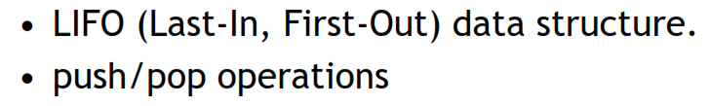

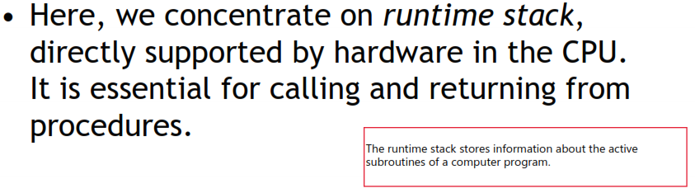
STACK OPERATIONS

Slide 6

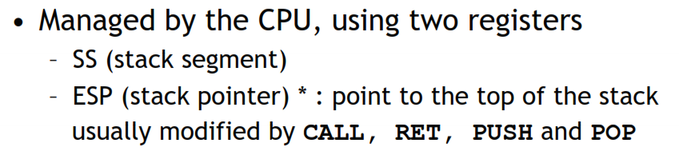
Runtime Stack

Slide 7
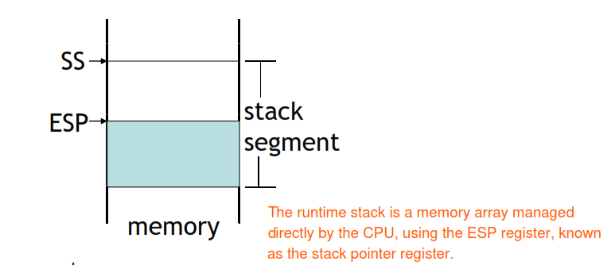
Runtime Stack

Slide 8
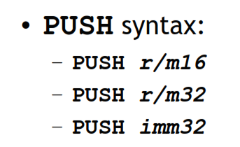
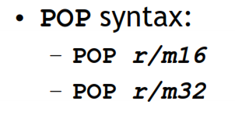
PUSH and POP instructions

Slide 9
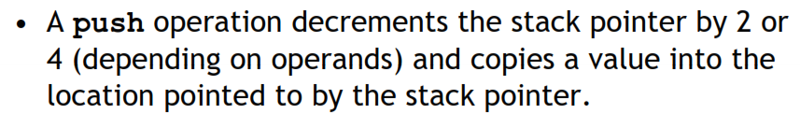
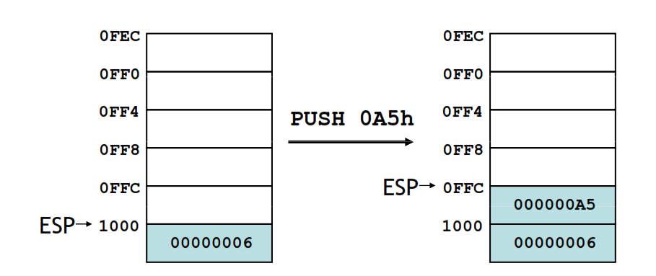
PUSH operation

Slide 10
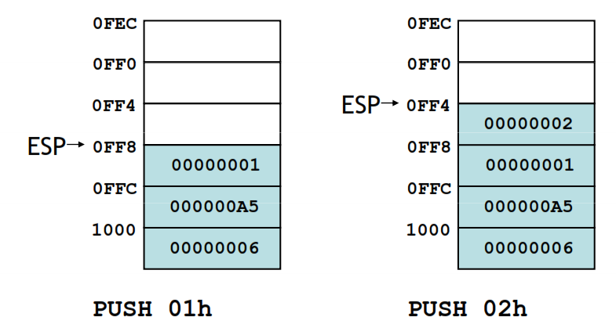
PUSH operation

Slide 11
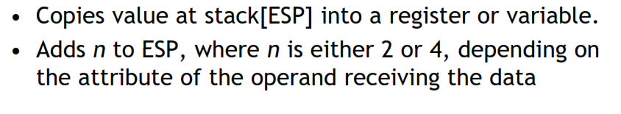
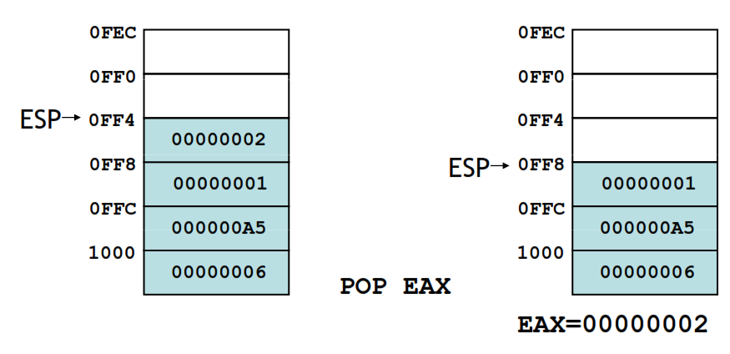
POP operation

Slide 12


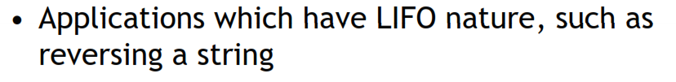
When to use stacks

Slide 13
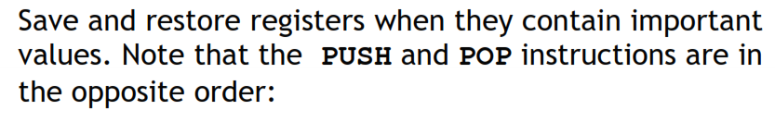
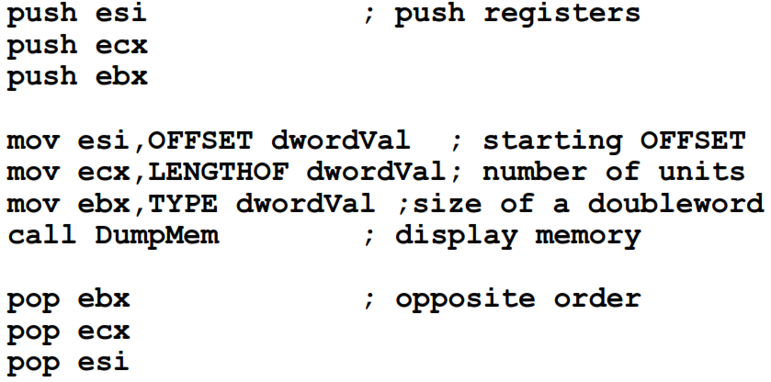
Example of using stacks

Slide 14

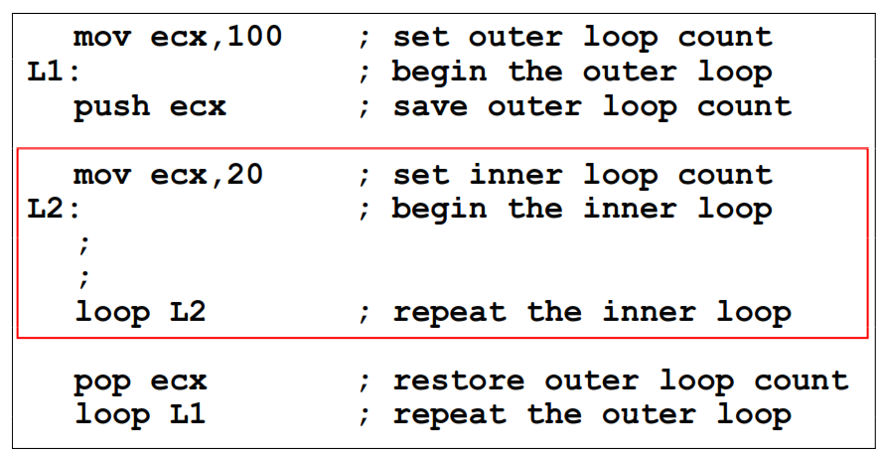
Example: Nested Loop

Slide 15
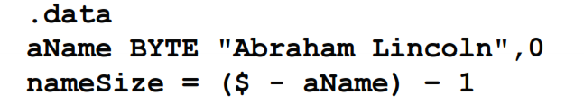
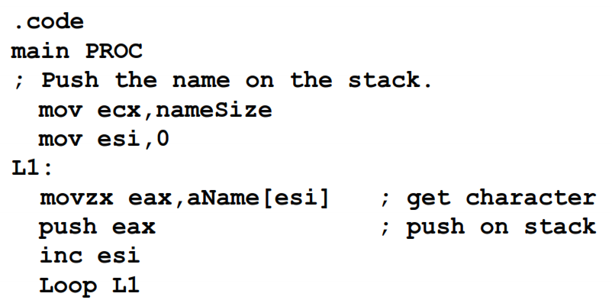
Example: reversing a string

Slide 16
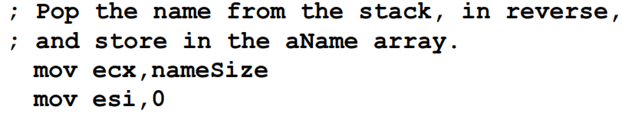
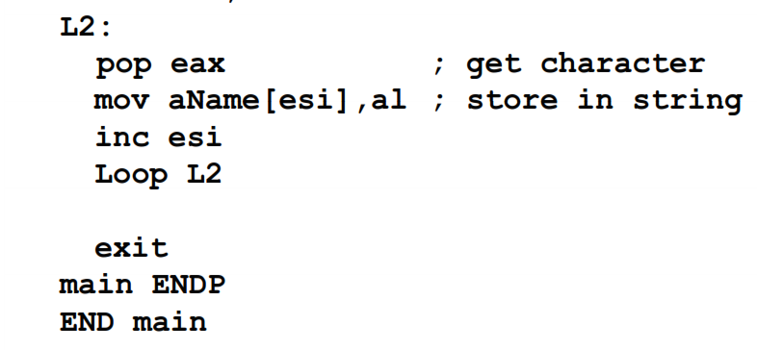
Example: reversing a string

Slide 17
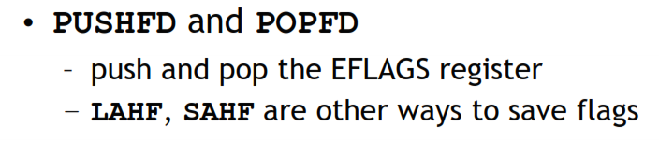
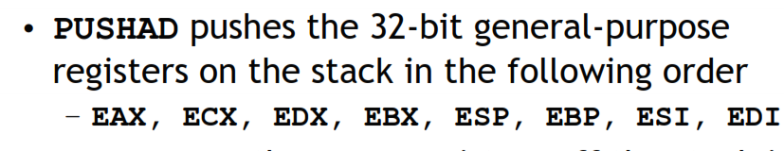
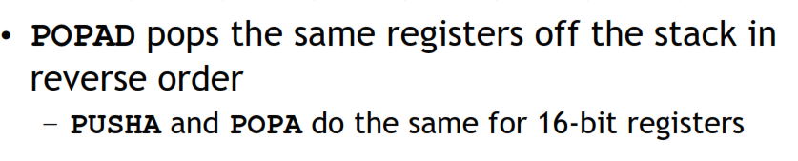
Related instructions

Slide 18



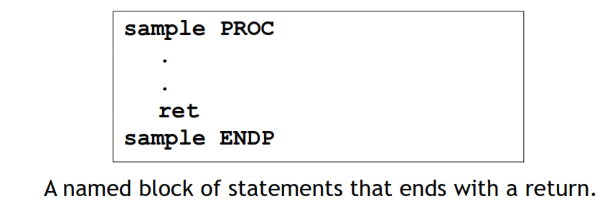
Defining and using procedures

Slide 19

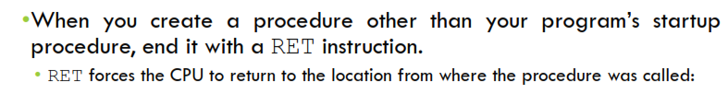
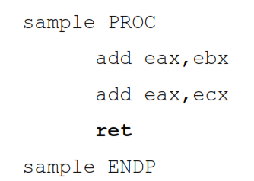

Slide 20
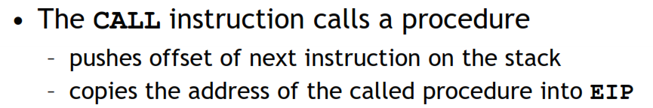
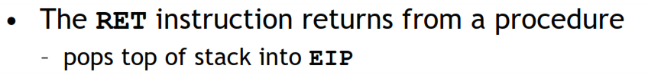
CALL and RET instructions

Slide 21
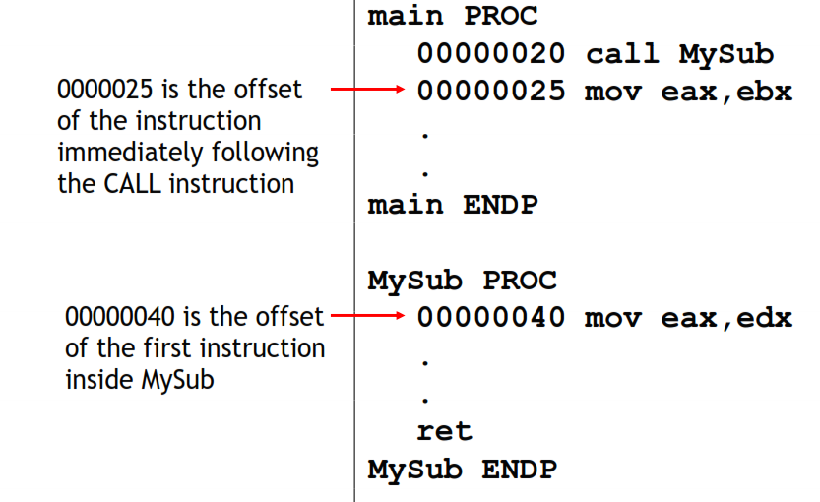
CALL-RET example (1 of 2)

Slide 22
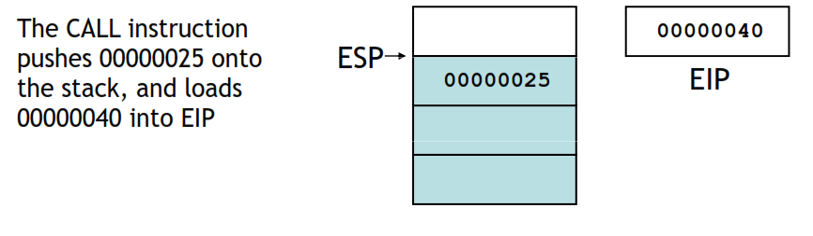
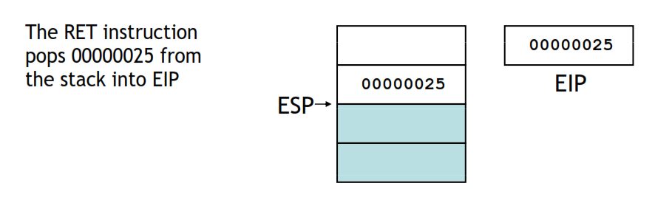
CALL-RET example (2 of 2)

Slide 23
Library Procedures - Overview (1 of 3)
CloseFile – Closes an open disk file
Clrscr - Clears console, locates cursor at upper left corner
CreateOutputFile - Creates new disk file for writing in output mode
Crlf - Writes end of line sequence to standard output
Delay - Pauses program execution for n millisecond interval
DumpMem - Writes block of memory to standard output in hex
DumpRegs – Displays general-purpose registers and flags (hex)
GetCommandtail - Copies command-line args into array of bytes
GetDateTime – Gets the current date and time from the system
GetMaxXY - Gets number of cols, rows in console window buffer
GetMseconds - Returns milliseconds elapsed since midnight

Slide 24
Library Procedures - Overview (2 of 3)
GetTextColor - Returns active foreground and background text colors in the console window
Gotoxy - Locates cursor at row and column on the console
IsDigit - Sets Zero flag if AL contains ASCII code for decimal digit (0–9)
MsgBox, MsgBoxAsk – Display popup message boxes
OpenInputFile – Opens existing file for input
ParseDecimal32 – Converts unsigned integer string to binary
ParseInteger32 - Converts signed integer string to binary
Random32 - Generates 32-bit pseudorandom integer in the range 0 to FFFFFFFFh
Randomize - Seeds the random number generator
RandomRange - Generates a pseudorandom integer within a specified range
ReadChar - Reads a single character from standard input

Slide 25
Library Procedures - Overview (3 of 3)
ReadDec - Reads 32-bit unsigned decimal integer from keyboard
ReadFromFile – Reads input disk file into buffer
ReadHex - Reads 32-bit hexadecimal integer from keyboard
ReadInt - Reads 32-bit signed decimal integer from keyboard
ReadKey – Reads character from keyboard input buffer
ReadString - Reads string from standard input, terminated by [Enter]
SetTextColor - Sets foreground and background colors of all subsequent console text output
Str_compare – Compares two strings
Str_copy – Copies a source string to a destination string
StrLength – Returns length of a string
Str_trim - Removes unwanted characters from a string.

Slide 26
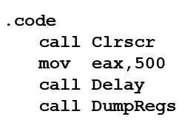
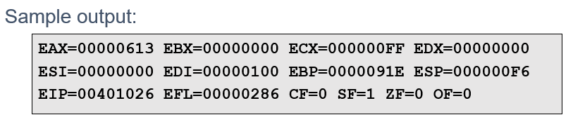
Example 1
TASK:-
Clear the screen, delay the program for 500 milliseconds, and dump the registers and flags.

Slide 27
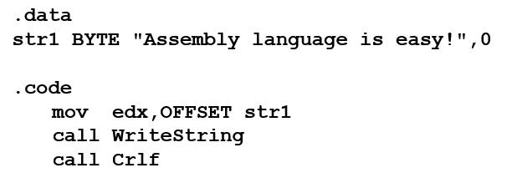
Example 2
TASK:-
Display a null-terminated string and move the cursor to the beginning of the next screen line.

Slide 28
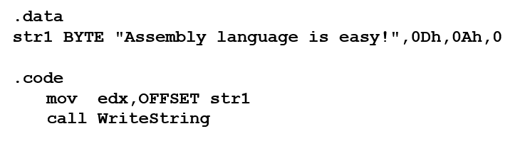
Example 2a
TASK:-
Display a null-terminated string and move the cursor to the beginning of the next screen line (use embedded CR/LF)

Slide 29
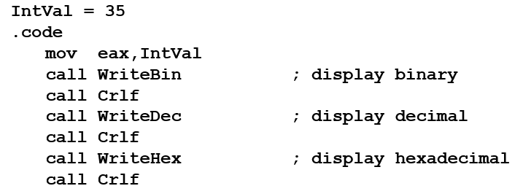
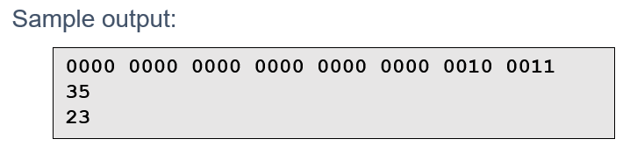
Example 3
TASK:-
Display an unsigned integer in binary, decimal, and hexadecimal, each on a separate line.

Slide 30
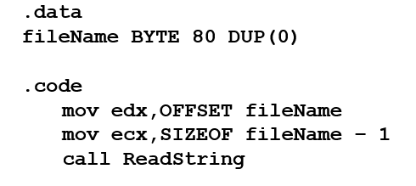
Example 4
TASK:-
Input a string from the user. EDX points to the string and ECX specifies the maximum number of characters the user is permitted to enter.

Slide 31
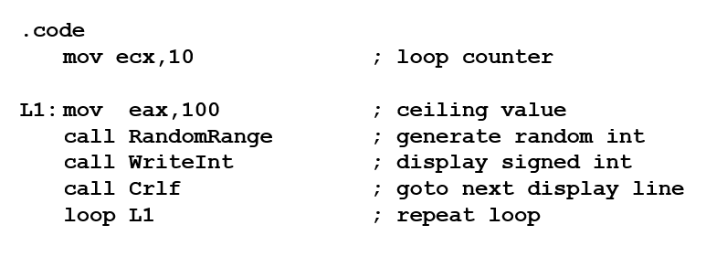
Example 5
TASK:-
Generate and display ten pseudo-random signed integers in the range 0 – 99. Pass each integer to WriteInt in EAX and display it on a separate line.

Slide 32
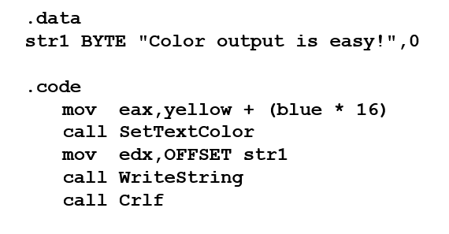
Example 6
TASK:-
Display a null-terminated string with yellow characters on a blue background.

Slide 33
Procedure parameters
A good procedure might be usable in many different programs
Parameters help to make procedures flexible because parameter values can change at runtime
General registers can be used to pass parameters

Slide 34
Documenting Procedures
Suggested documentation for each procedure:
A description of all tasks accomplished by the procedure.
Receives: A list of input parameters; state their usage and requirements.
Returns: A description of values returned by the procedure.
Requires: Optional list of requirements called preconditions that must be satisfied before the procedure is called.
If a procedure is called without its preconditions satisfied, it will probably not produce the expected output.

Slide 35
Example: SumOf Procedure
;---------------------------------------------------------
SumOf PROC
;
; Calculates and returns the sum of three 32-bit integers.
; Receives: EAX, EBX, ECX, the three integers. May be
; signed or unsigned.
; Returns: EAX = sum, and the status flags (Carry,
; Overflow, etc.) are changed.
; Requires: nothing
;---------------------------------------------------------
add eax,ebx
add eax,ecx
ret
SumOf ENDP

Slide 36
Nested Procedure Calls
By the time Sub3 is called, the stack contains all three return addresses:

Slide 37
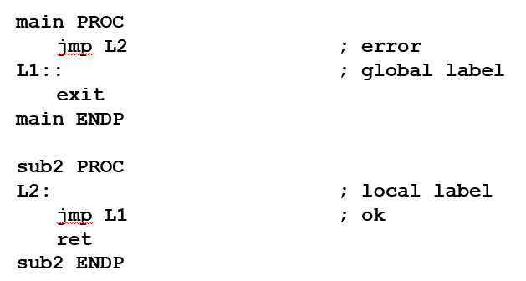
Local and Global labels
A local label is visible only to statements inside the same procedure
A global label is visible everywhere . Global label identified by double colon (::)

Slide 38
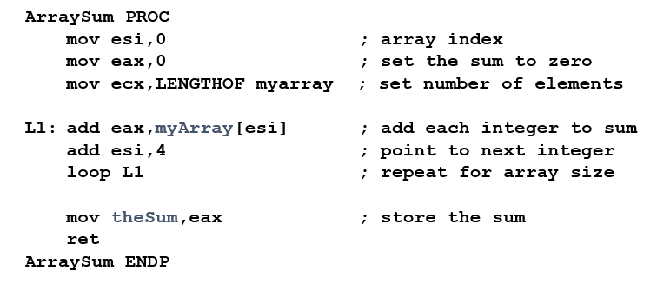
Example 7
TASK:-
The ArraySum procedure calculates the sum of an array. It makes two references to specific variable names:

Slide 39
EXERCISE
What if you wanted to calculate the sum of two or three arrays within the same program?

Slide 40
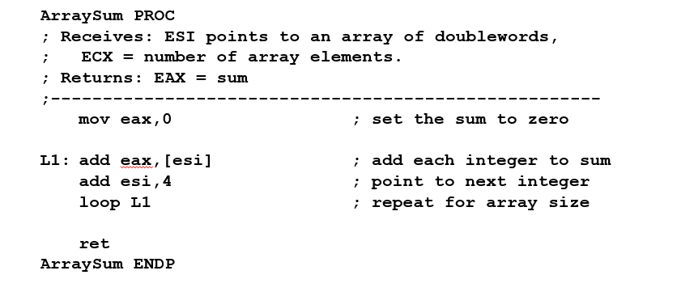
Example 8
TASK:-
This version of ArraySum returns the sum of any doubleword array whose address is in ESI. The sum is returned in EAX:

Slide 41
USES Operator
Lists the registers that will be saved (to avoid side effects) (return register shouldn’t be saved)
ArraySum PROC USES esi ecx
mov eax, 0 ; set the sum to zero
...
MASM generates the following code
ArraySum PROC
push esi
push ecx
..
pop ecx
pop esi
ret
ArraySum ENDP

Slide 42
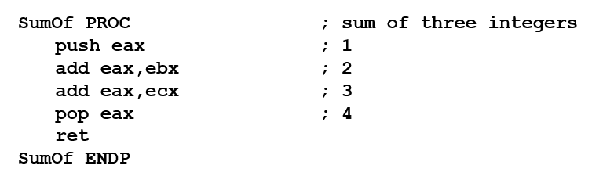
When not to push a register
The sum of the three registers is stored in EAX on line (3), but the POP instruction replaces it with the starting value of EAX on line (4):

Slide 43
RET Instruction
Return from subroutine
Pops stack into the instruction pointer (EIP or IP), control transfers to the target address
Syntax:
RET
RET n
Optional operand n causes n bytes to be added to the stack pointer after EIP (or IP) is assigned a value

Slide 44


